Slide 1

Minor Project Final Evaluation
Submitted By:
Devanshu Madan(40413303115)
Prachi Panchal(40113307716)
Ritvik Chotani(41713303115)
Swastik Arora(40813303115)

Slide 2


Project Title
“Blood Bank” Android Application

Slide 3

Requirements for the Application Creation
Hardware Requirements
- Intel i5 Processor.
- 4GB RAM(Minimum)
Software Requirements
- Android Studio
- Android Emulator
- Android SDK

Slide 4

Requirements to Run Application
Software
- Android Version > 4.4
Hardware
- None

Slide 5
Project Coding Languages Requirements
Java
Android
XML

Slide 6
Project Developers(Department Wise)
Front-End
- Managed By:
- Devanshu Madan
- Prachi Panchal
Back-End
- Managed By:
- Swastik Arora
- Ritvik Chotani

Slide 7
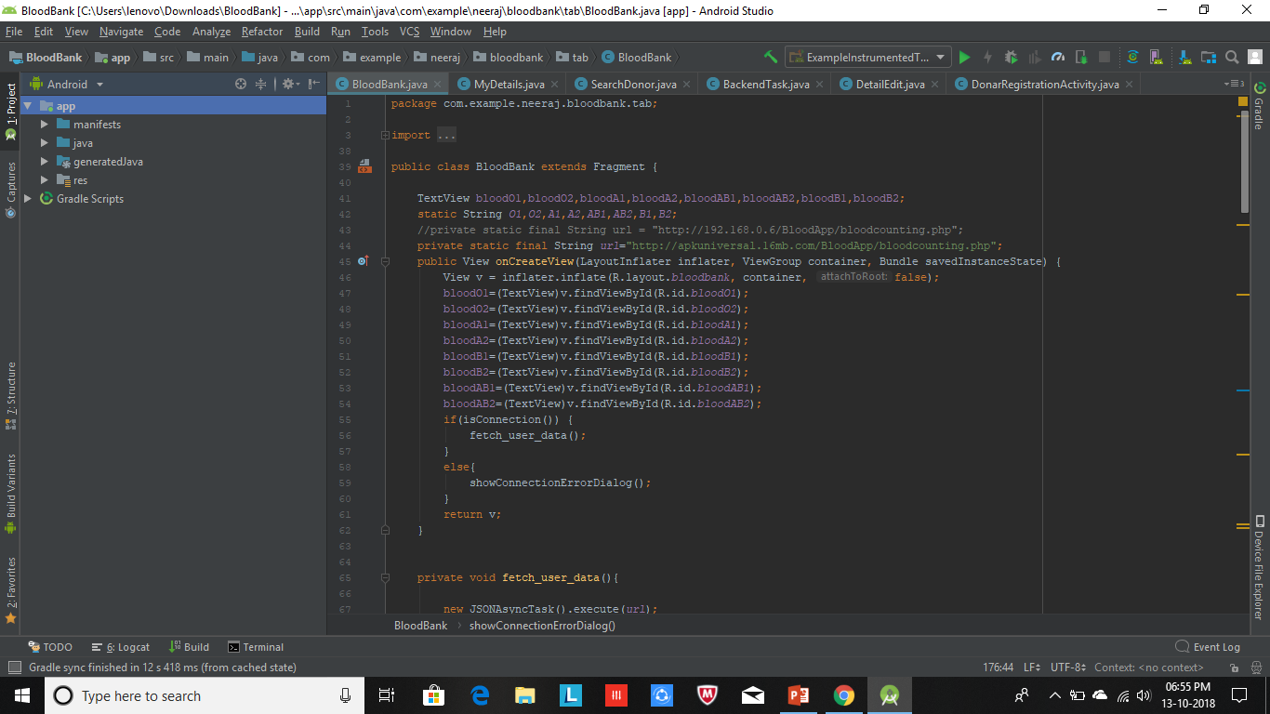
Project Code Snippets

Slide 8
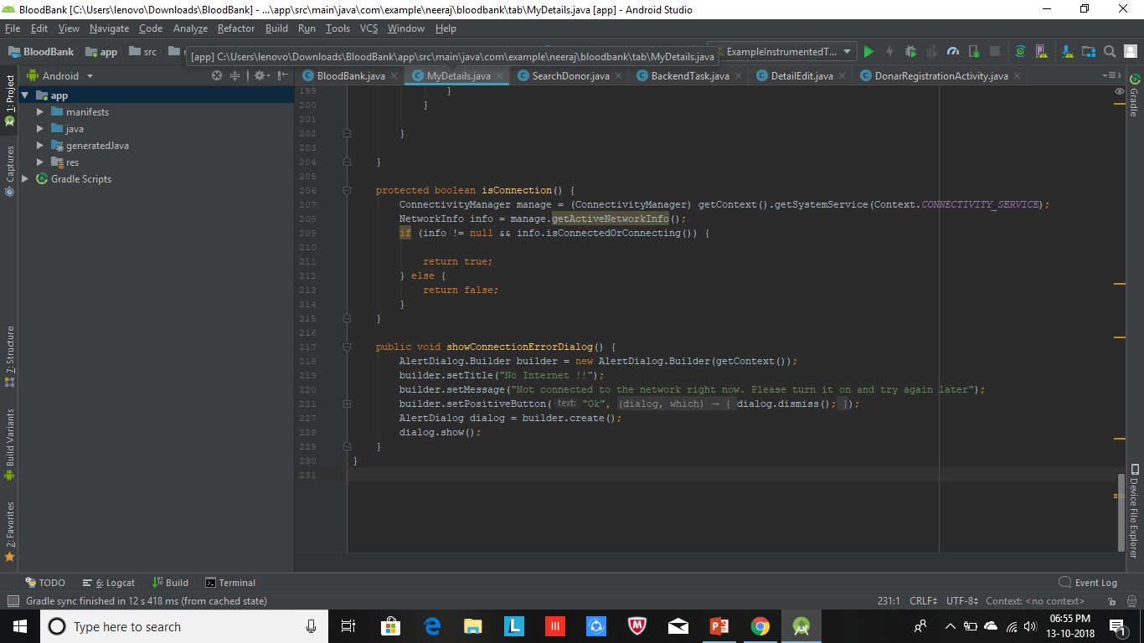

Slide 9
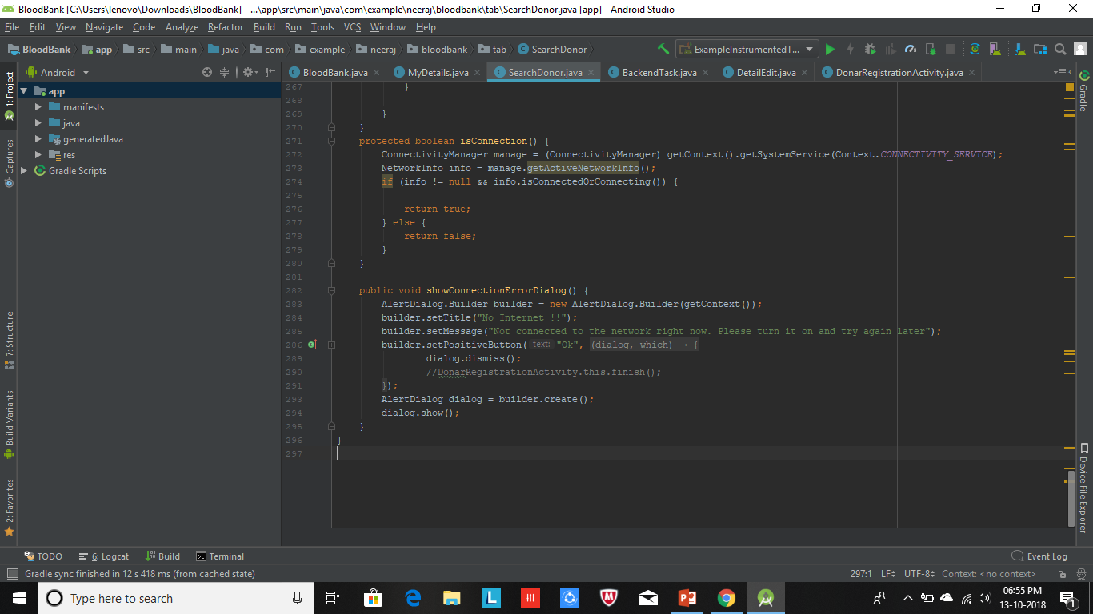

Slide 10
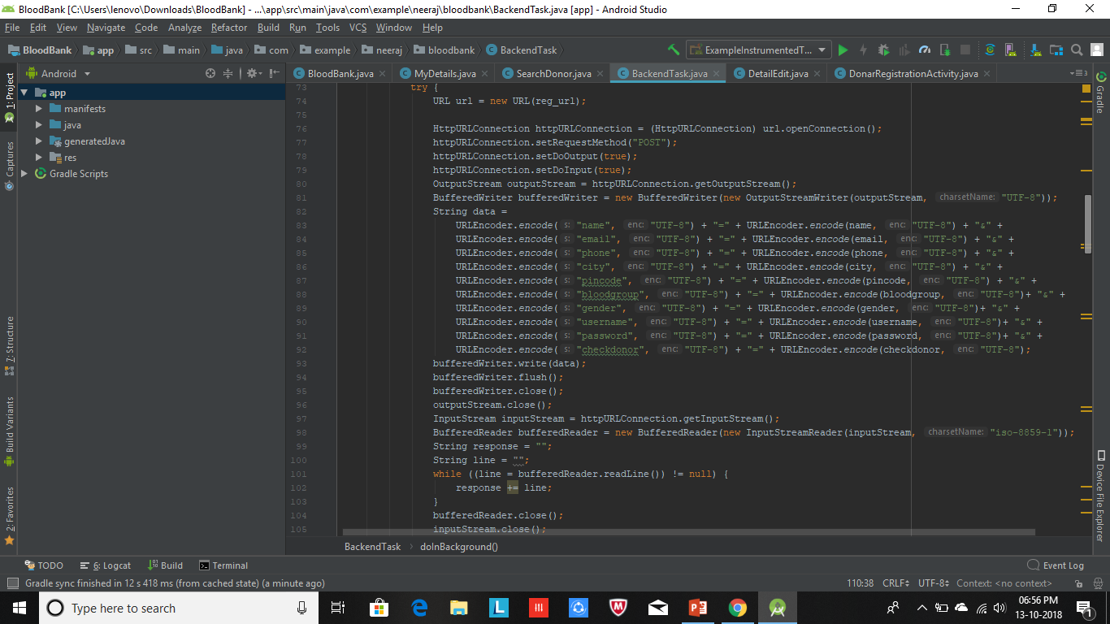

Slide 11
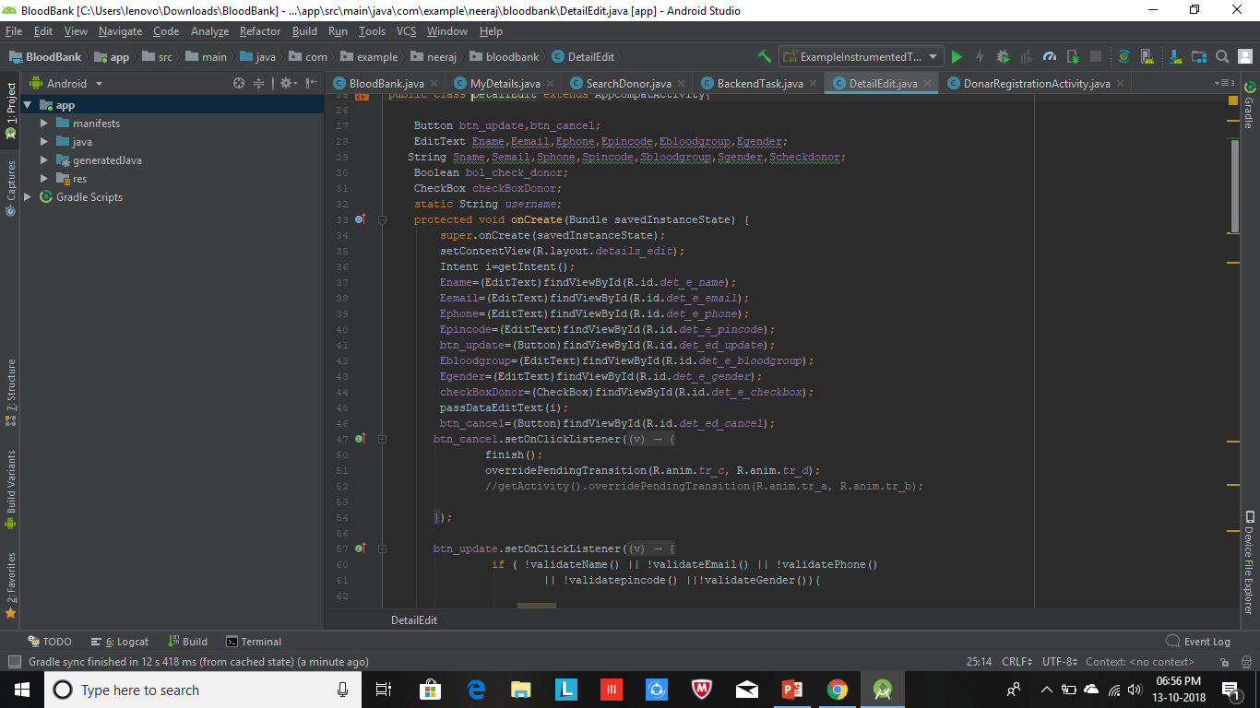

Slide 12
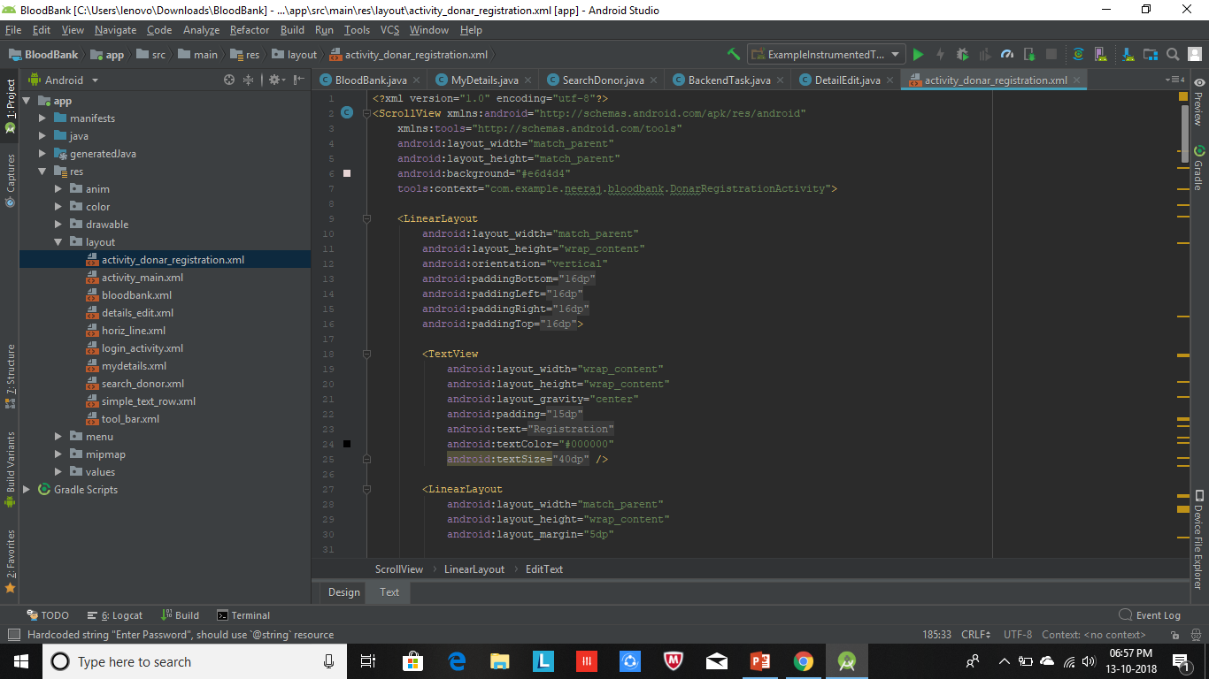

Slide 13
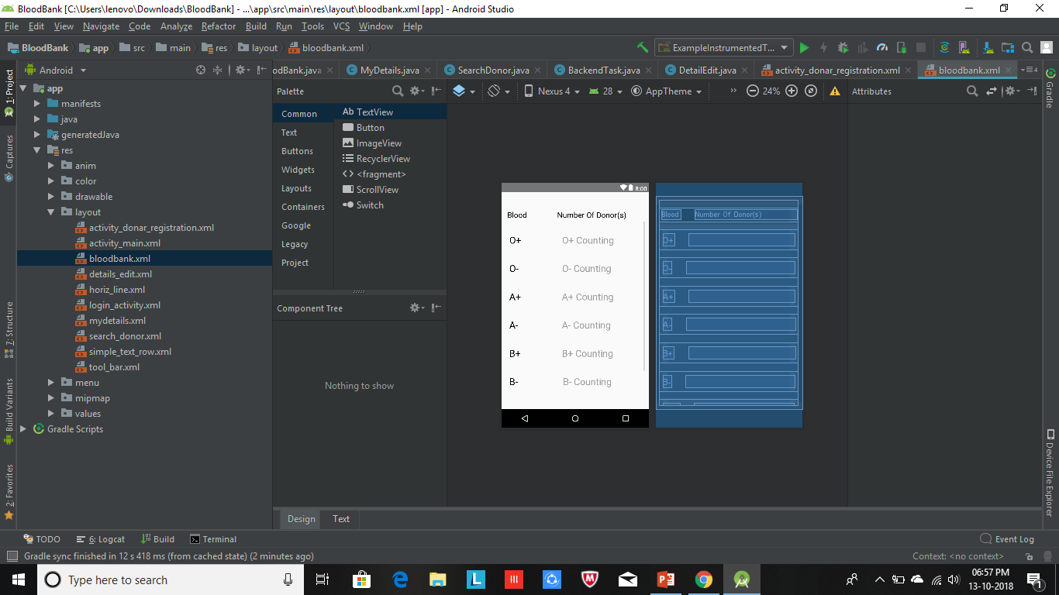

Slide 14
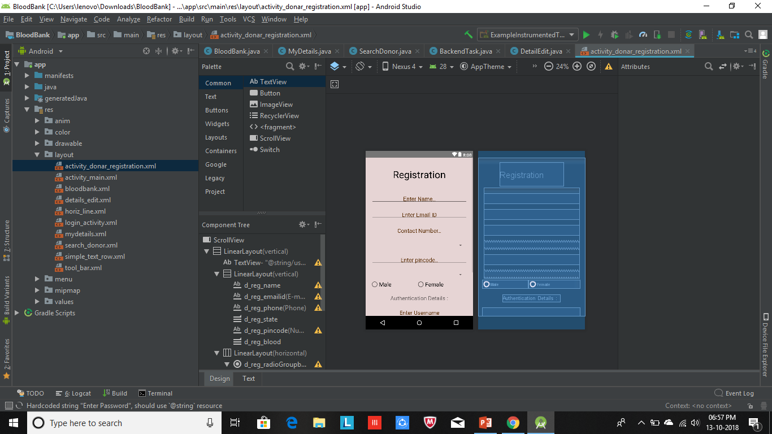

Slide 15
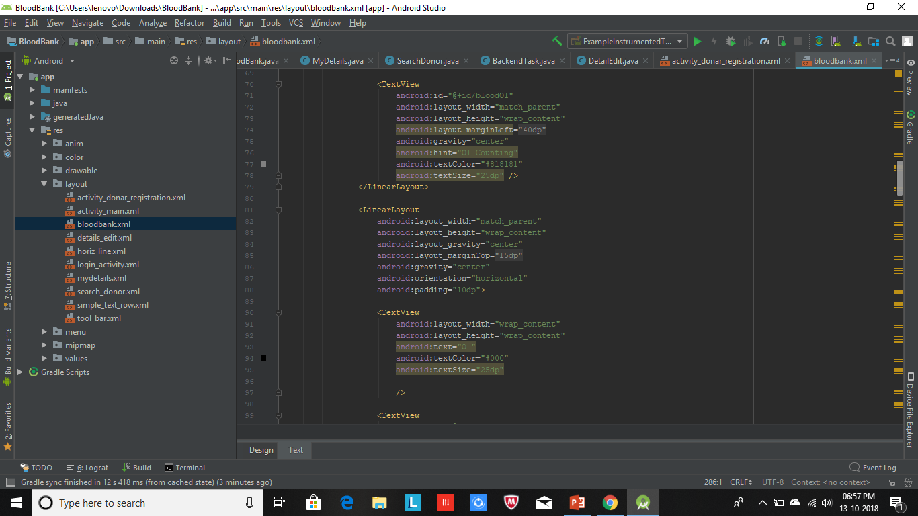

Slide 16
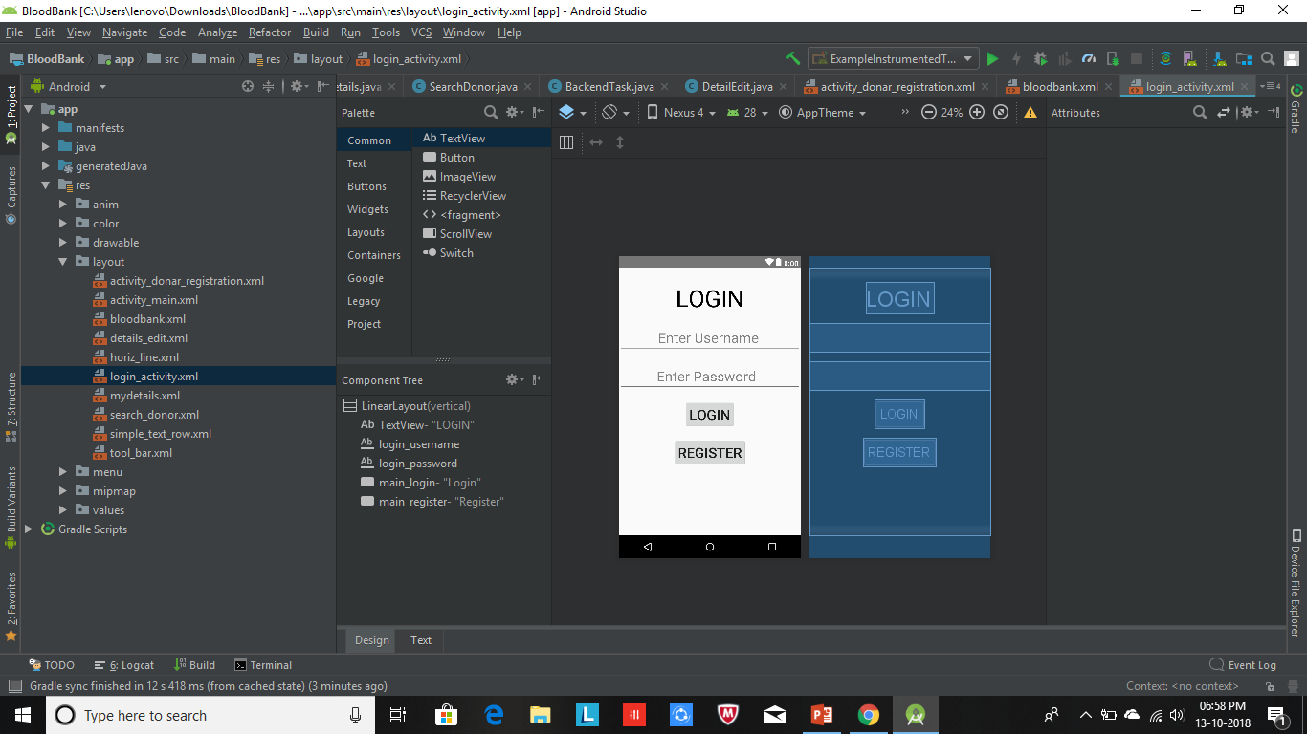

Slide 17
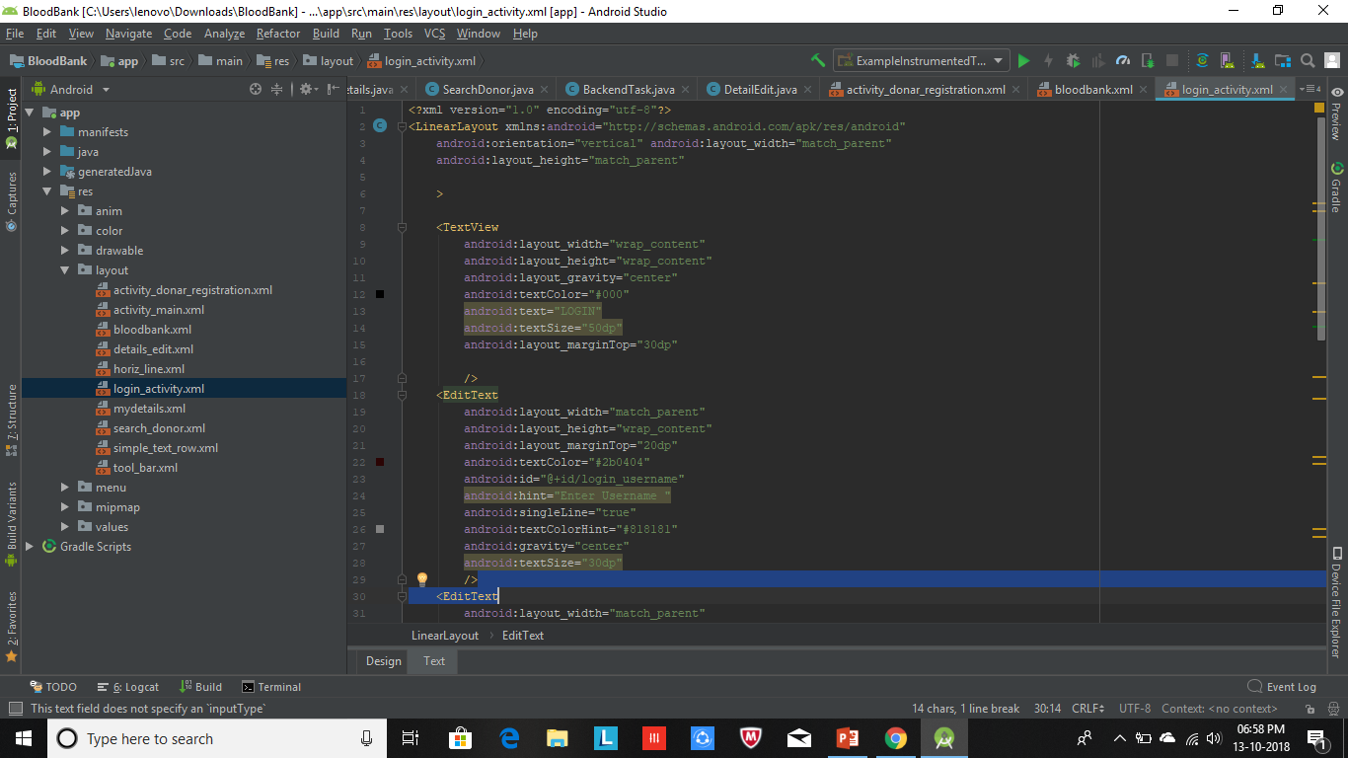

Slide 18
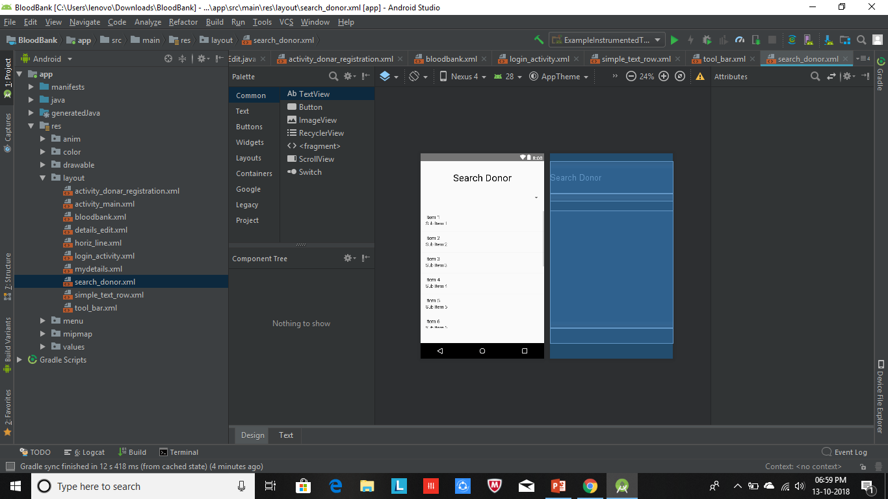

Slide 19
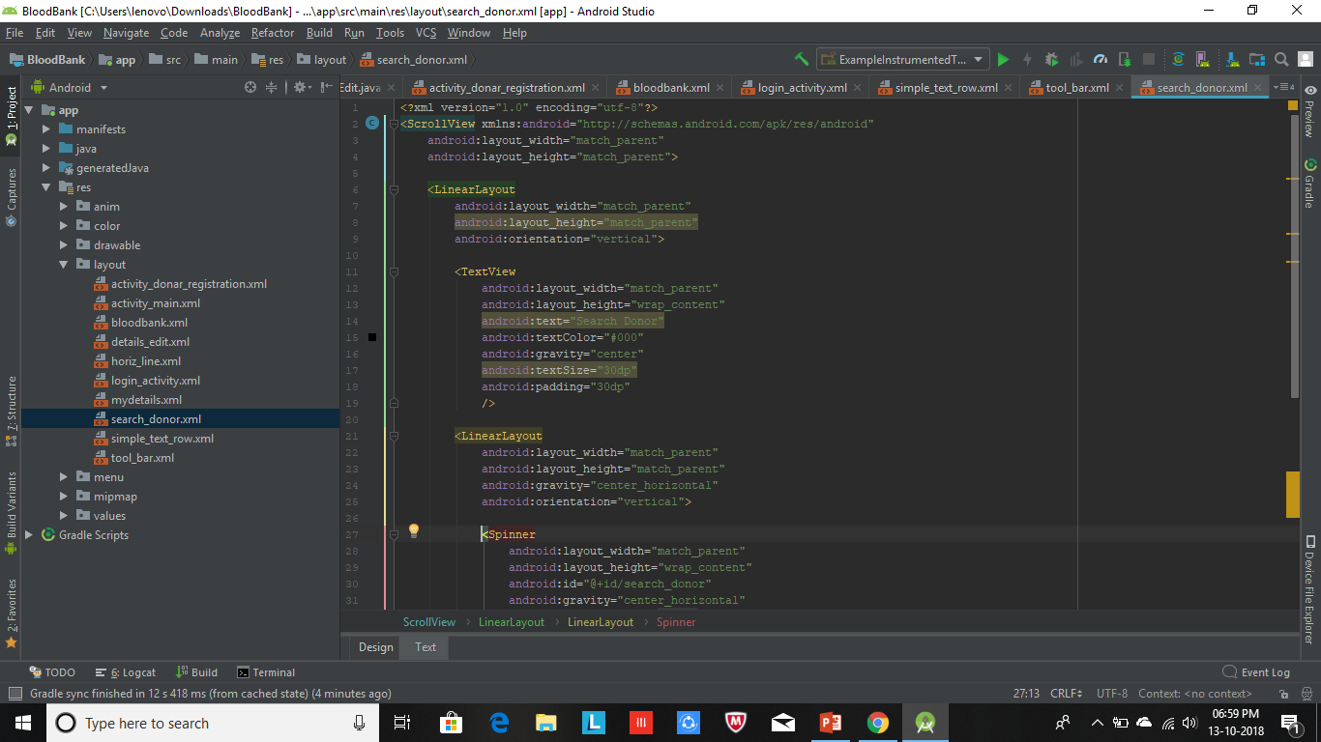

Slide 20
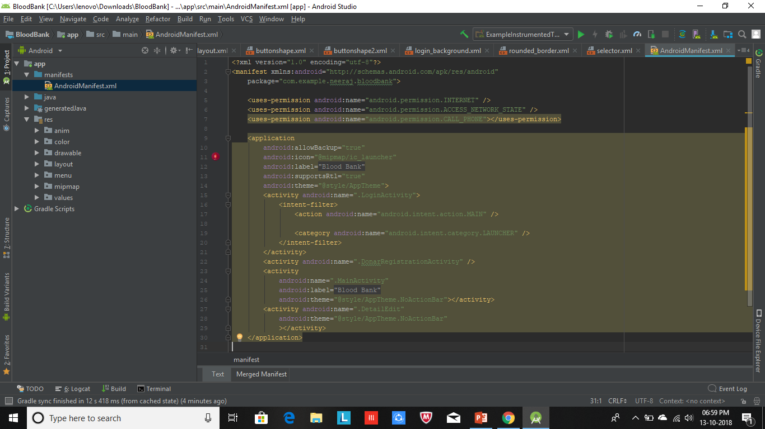

Slide 21
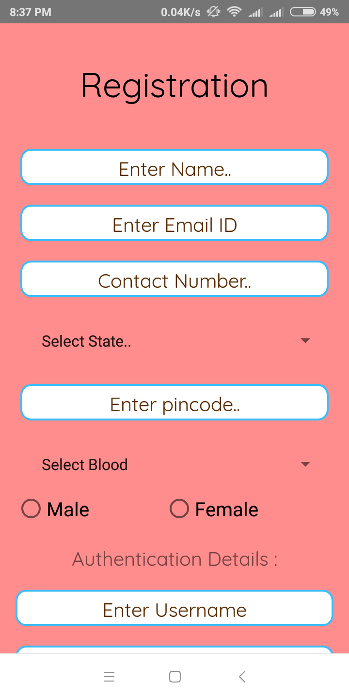
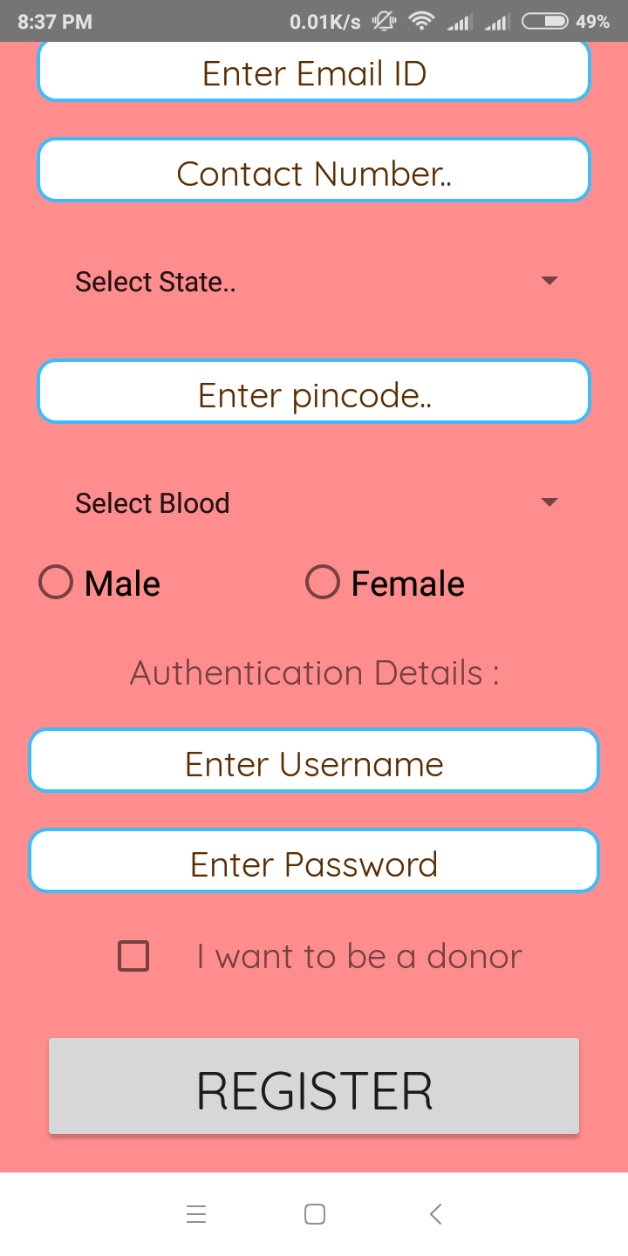
Project Screenshots

Slide 22
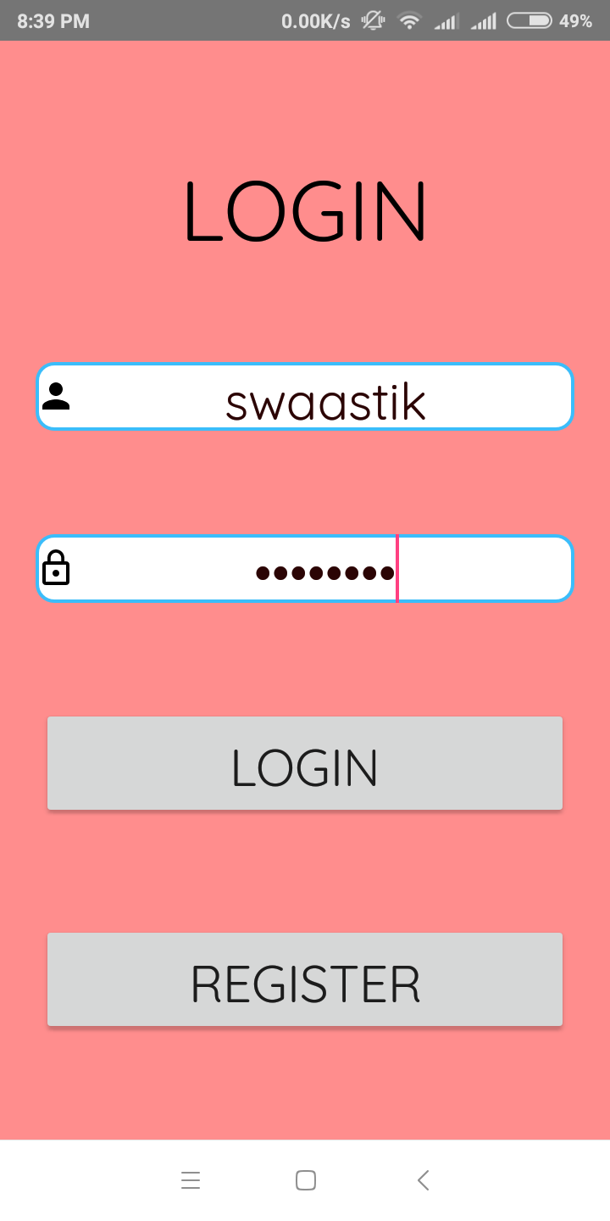

Slide 23
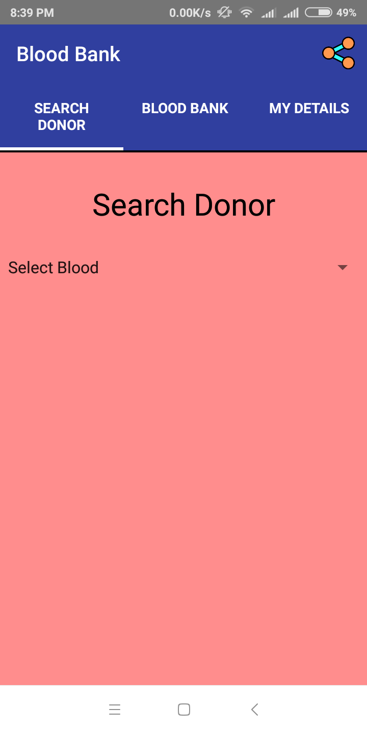

Slide 24
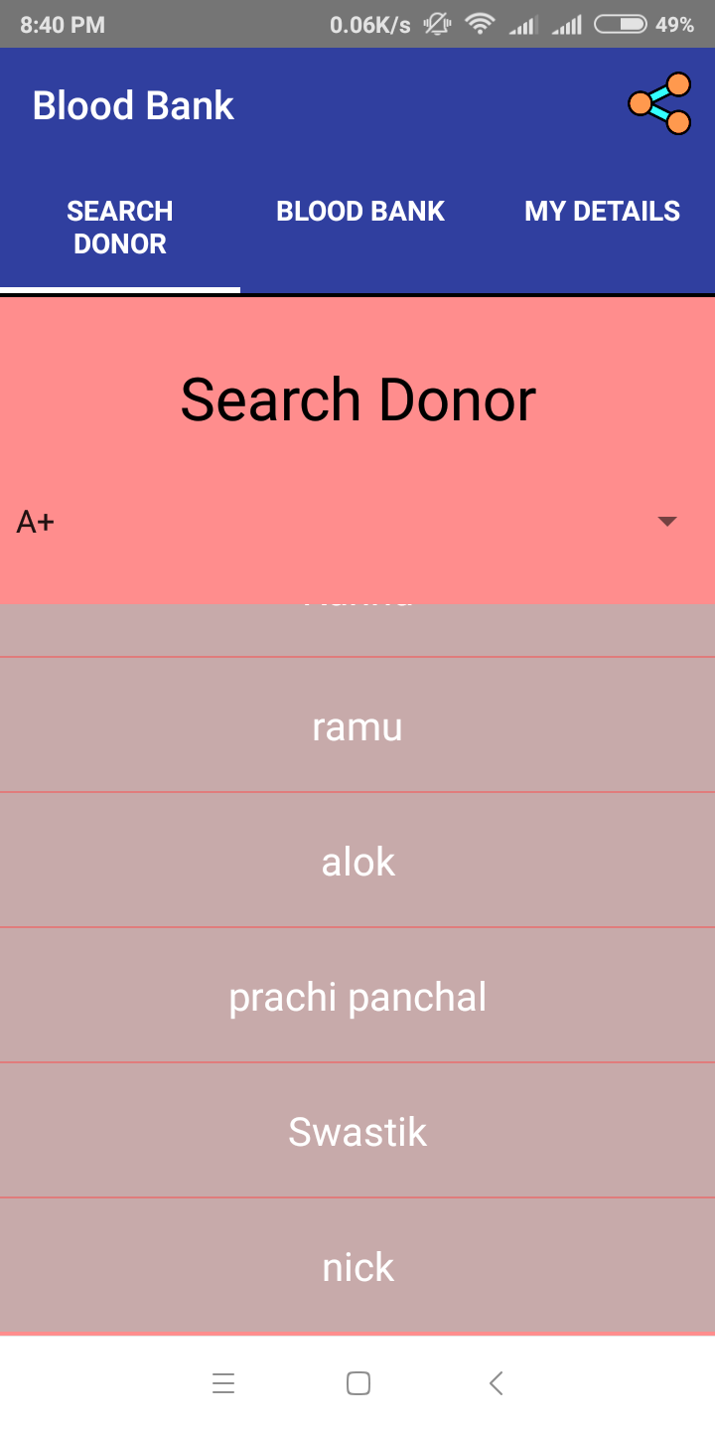

Slide 25
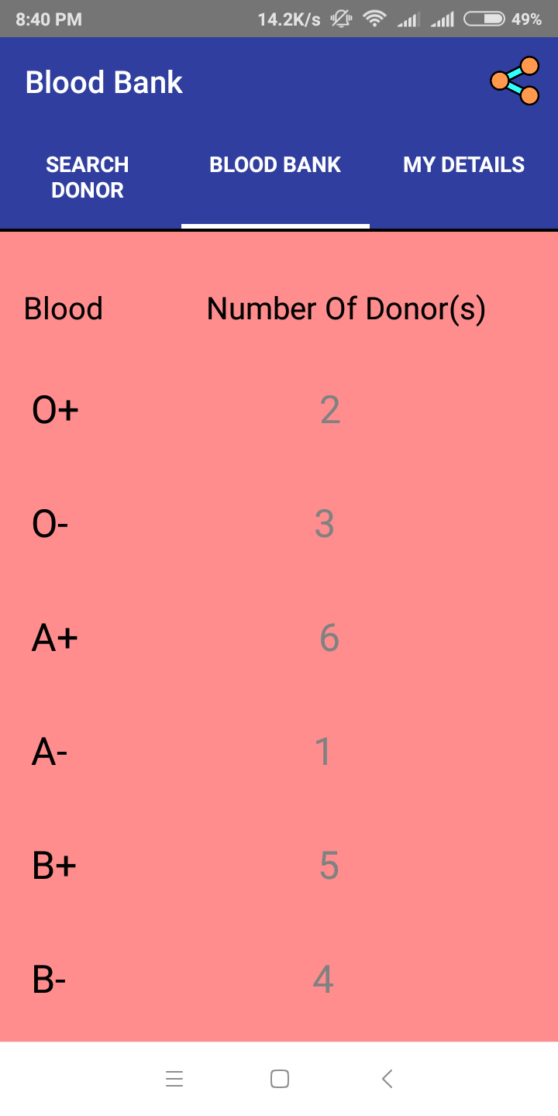

Slide 26
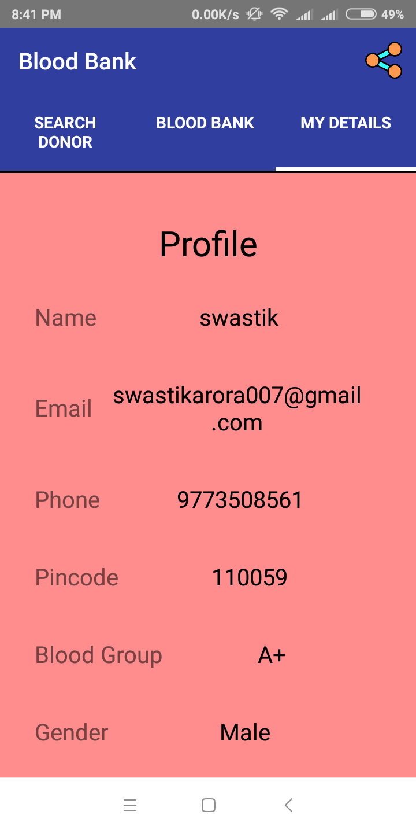

Slide 27
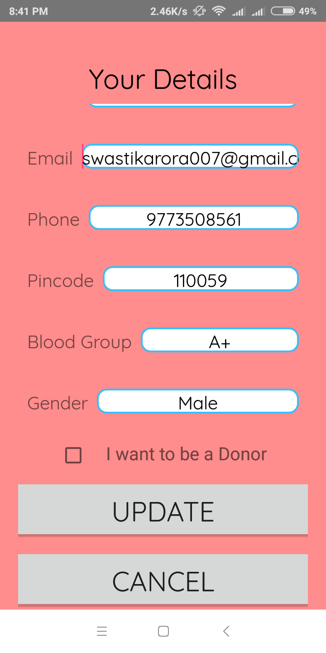

Slide 28
Future Scope
We propose to continue our development activities in Android, Java to be part of the ongoing Innovations happening in the Industry.
We also would seek to found a company to slowly build on Android development leveraging Google App Engine.
We hope to work under the guidance and facilitation of the HMRITM faculty to interact with the Industry (both Developer community and Hardware manufacturers) for Enabling us to undertake live projects as per requirements of the Industry.

Slide 29
Conclusion
The Aim of the Project was to give user easy access to various Blood Bank Donors.
The project has been completed successfully which covering the maximum requirement given by all of the Group & our Mentor.
The system is made flexible and versatile.
This software is developed with scalability in mind. Additional modules can be easily added when necessary.

Slide 30
References
https://developer.android.com/docs/
https://www.ndtv.com/health/why-is-there-a-blood-shortage-in-india-1712012
https://www.udemy.com/learn-android-application-development-y/learn/v4/content

Slide 31

THANK YOU
Brought to you by :-
Devanshu Madan(40413303115)
Swastik Arora(40813303115)
Ritvik Chotani(41713303115)
Prachi Panchal(40113307716)
I.T.(VIIth Semester)

